Slide 1
Chest X-Ray Analysis
Ryan S. Chung

Slide 2
AGENDA
Introduction
Data
Methods
Results
Summary

Slide 3
INTRODUCTION
For this project, the presented business problem was to assist an agency in identifying whether chest x-ray images indicated signs of Pneumonia or not. Our goal for this project was to create an image classification model that would accurately predict whether a provided chest x-ray was healthy or not.

Slide 4
Data
For this project, a dataset from Kaggle called Chest X-Ray Images (Pneumonia) was used. It should also be mentioned that the initial source of images for the Kaggle dataset were obtained from Mendeley Data which houses thousands of validated OCT and Chest X-Ray images. The data from the Kaggle set was well organized which made its use for the completion of this project swift. As stated earlier, the images from the Kaggle dataset consisted of healthy chest X-rays and chest X-rays with indications of Pneumonia.

Slide 5
Methods
In this project, initially a Multi-Layer Perception model was created. After the MLP was created, we then moved forward to creating a Convolutional Neural Network model. Once the model had been created, it was then run through a grid search using Talos in order to find the best parameters for the model.

Slide 6
Results

Slide 7
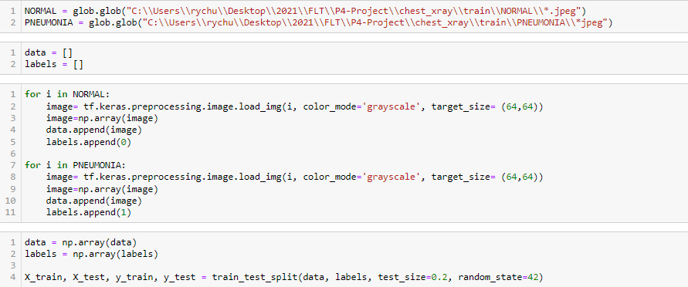
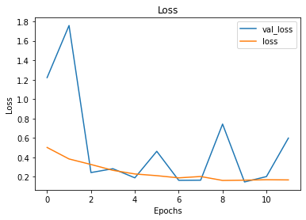
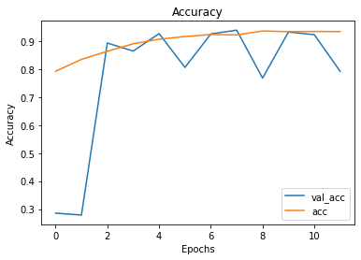
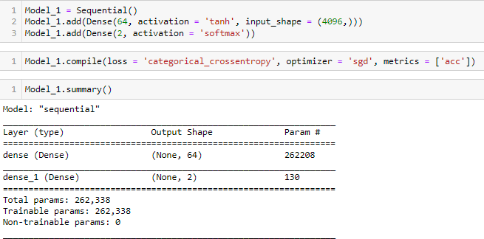
Initial MLP

Slide 8
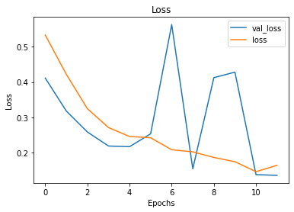
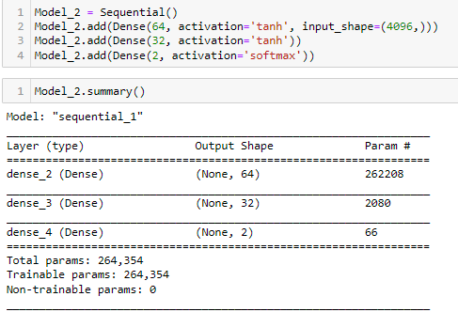
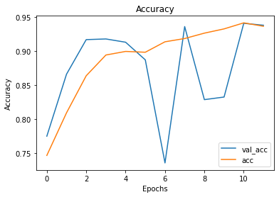
2nd MLP

Slide 9
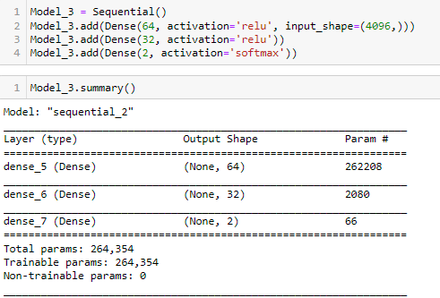
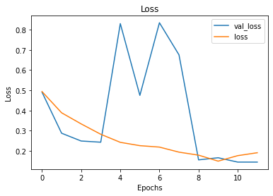
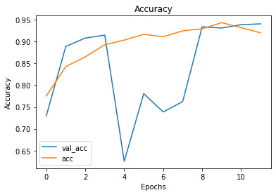
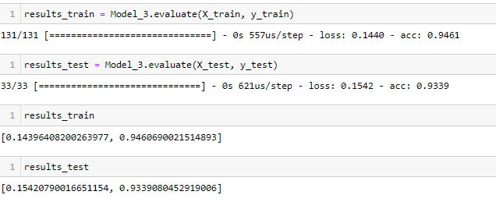
3rd MLP

Slide 10
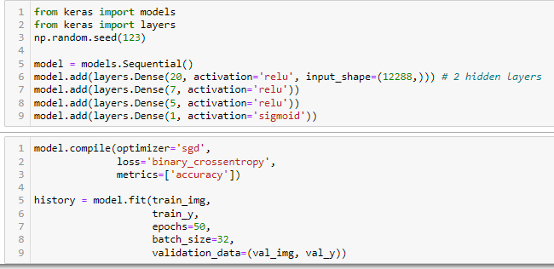
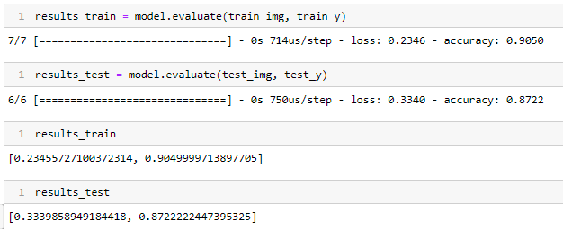
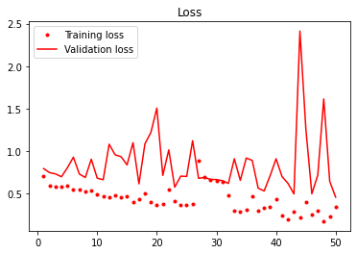
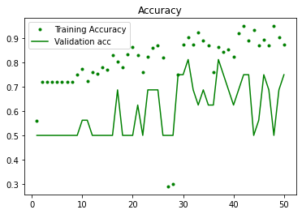
Initial CNN

Slide 11
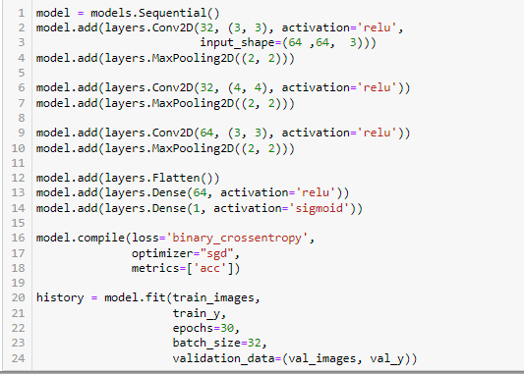
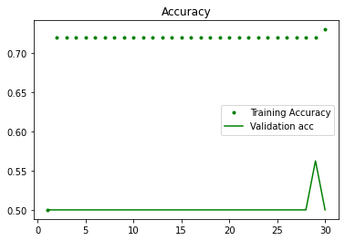
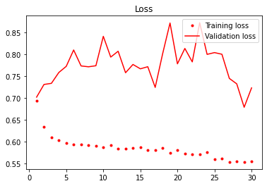
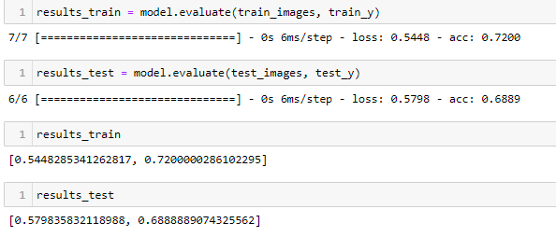
2nd CNN

Slide 12
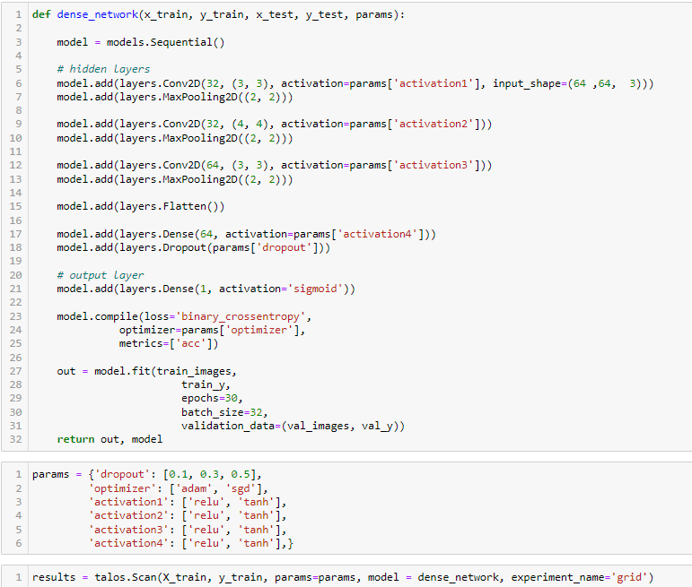
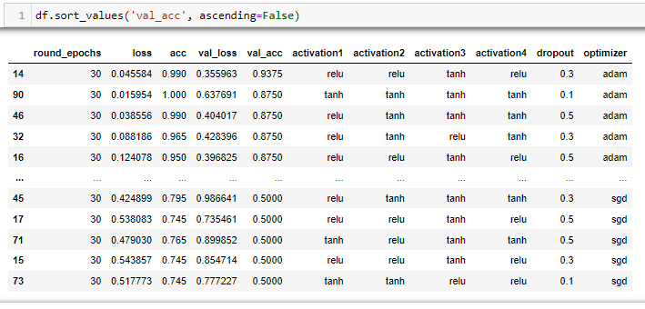
Tuning with Talos

Slide 13
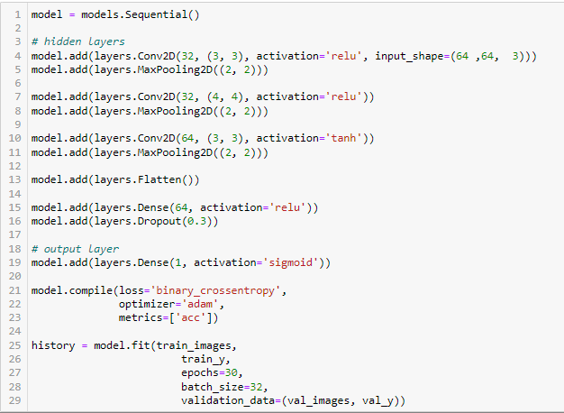
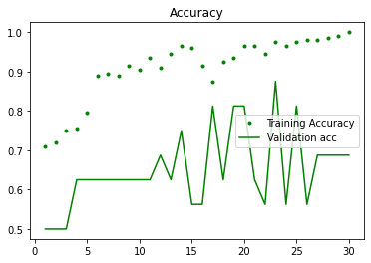
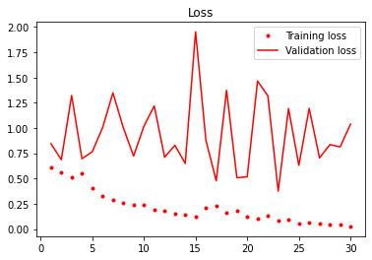
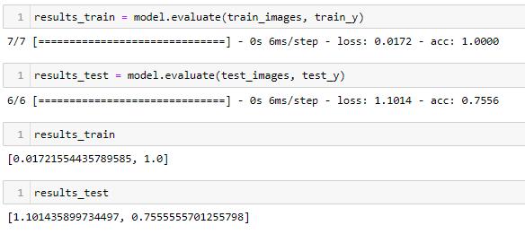
Final Model

Slide 14
Conclusion
1
Our final MLP model had an accuracy of 94% on the training set of images.
2
The final MLP model had an accuracy of 93% on the testing set of images.
3
After being run through a grid search, the final Convolutional Neural Network had an accuracy of 100% on the training set of images.
4
After being run through a grid search, the final Convolutional Neural Network had an accuracy of 75% on the training set of images.

Slide 15
Questions?

Slide 16
THANK YOU

